Slide 1
Secure Data hiding in images using stegnography
CAPSTONE PROJECT
Presented By: VEMULA SUSHMA
College Name & Department : St . Mary’s Women’s Engineering College , BTECH CSE

Slide 2
OUTLINE
Problem Statement
Technology used
Wow factor
End users
Result
Conclusion
Git-hub Link
Future scope

Slide 3
Problem Statement
Why is it needed?
Secure communication is crucial in the digital era.
Traditional encryption methods can raise suspicion.
Image steganography enables covert message embedding.
Project Goal:
Develop a user-friendly tool for hiding messages securely in images.
Enhancements:
Use a small diagram showing "Plain Image → Stego Image" process.

Slide 4
Technology used
Programming Language: Python
Libraries Used:
OpenCV (cv2) – Image Processing
Tkinter – GUI Interface
NumPy – Data Handling
OS – File Management

Slide 5
Wow factors
Simple and intuitive GUI using Tkinter
Strong security with password-based access
Efficient image processing using OpenCV
Ensures minimal image distortion while embedding messages

Slide 6
End users
Individuals who require secure private communication
Cybersecurity enthusiasts and researchers
Journalists and activists in need of secure message exchange
Digital forensic experts

Slide 7
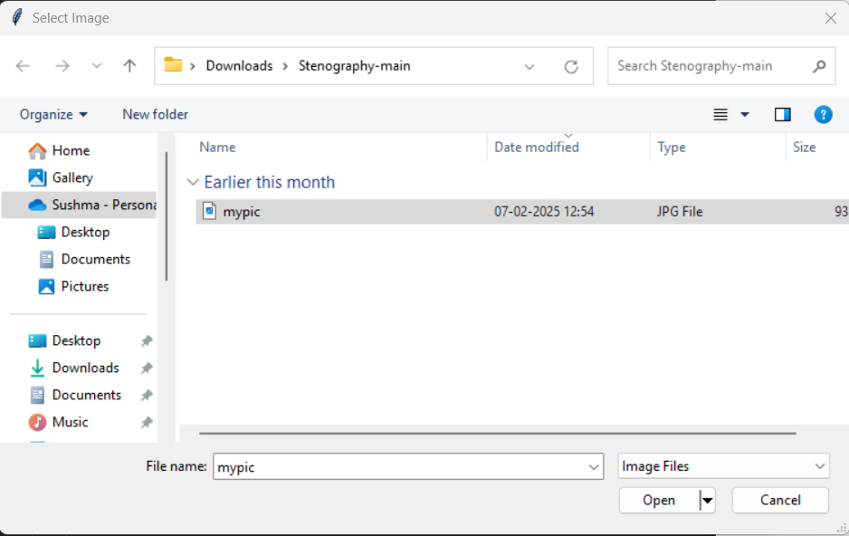
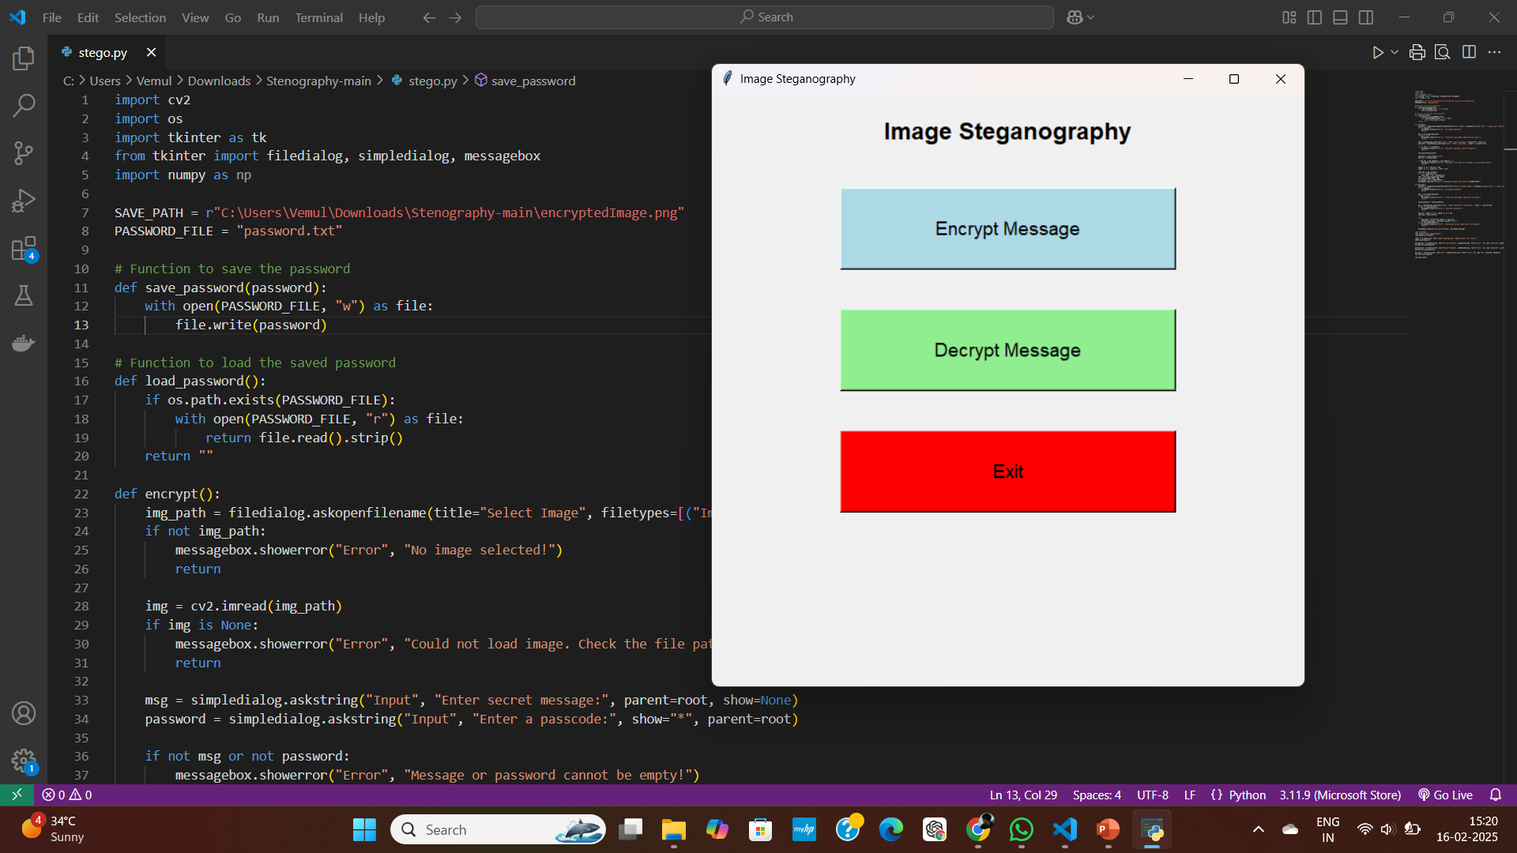
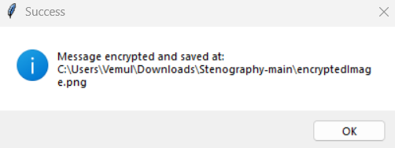
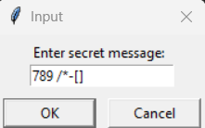
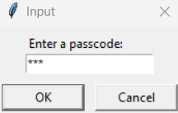
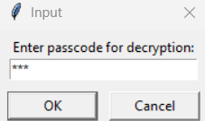
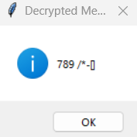
Results

Slide 8
Conclusion
Image steganography provides a discreet way to send hidden messages.
The project successfully embeds and extracts messages with password security.
Enhances digital communication security without raising suspicion.

Slide 9
GitHub Link
https://github.com/sushmavemula90/Steganography.git

Slide 10
Future scope
Support for multiple image formats (JPG, PNG, BMP, etc.)
Implementation of AI-based detection resistance
Increased capacity for message storage without visual artifacts
Cloud-based steganography application for remote access

Slide 11
THANK YOU

